Slide 1
Health Data Research UK: Addressing the digital skills shortage
Gabriella Rustici, HDR UK Associate Director of Training
gabriella.rustici@hdruk.ac.uk
NHSR Conference, 5 November 2019
Notes:
Intro to hdruk, how we are addressing the digital skill shortage in health data science and how we can collaborate with NHSR community around training and CB

Slide 2










A national Institute for health data science
Launched in April 2018, we work in partnership with the NHS, industry, academia and patients, and by making health data available to researchers and innovators we can better understand diseases and find ways to prevent, treat and cure them.
We are funded by UK Research and Innovation, the Medical Research Council, the British Heart Foundation, the National Institute for Health Research, the Economic and Social Research Council, the Engineering and Physical Sciences Research Council, Health and Care Research Wales, Health and Social Care Research and Development Division (Public Health Agency, Northern Ireland), Chief Scientist Office of the Scottish Government Health and Social Care Directorates, and the Wellcome Trust.

Slide 3
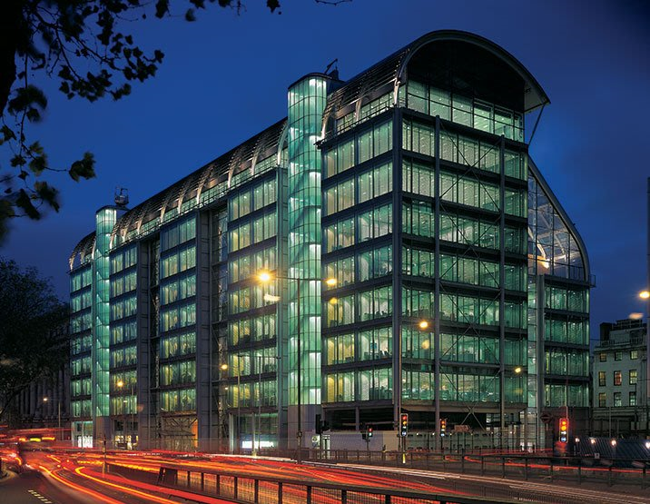
About Health Data Research UK
Operating Model
One single national institute
Federated across the UK
Ten funders
Strong Board
Separate legal entity, tiered structure
Wellcome Trust base
Not a data controller
Partnerships with academia, industry, NHS, charities

Slide 4


Our vision
Our vision is for large scale data and advanced analytics to benefit every patient interaction, clinical trial, biomedical discovery and enhance public health.
Notes:
Our vision is that every health and care interaction and research endeavour will be enhanced by access to large scale data and advanced analytics.
share information, insights and innovations so that we learn faster together.
overcome challenges to create a new and thriving health data ecosystem
interdisciplinary way
try new things, take risks, embrace ambiguity and challenge the status quo
find partners who can help fill those gaps and value and respect their contribution

Slide 5
We will deliver our mission through a united strategy
PUBLIC TRUST
SCIENCE
PEOPLE
DELIVERY
INFRASTRUCTURE
GOVERNANCE
Notes:
A collaboration of this scale has never been seen before and it will significantly transform the future of healthcare by developing and championing the best in science, people and infrastructure. Each of these elements has a crucial part to play in advancing healthcare improvements and will fuse together to create an unparalleled ecosystem for health data science and innovation to flourish.

Slide 6
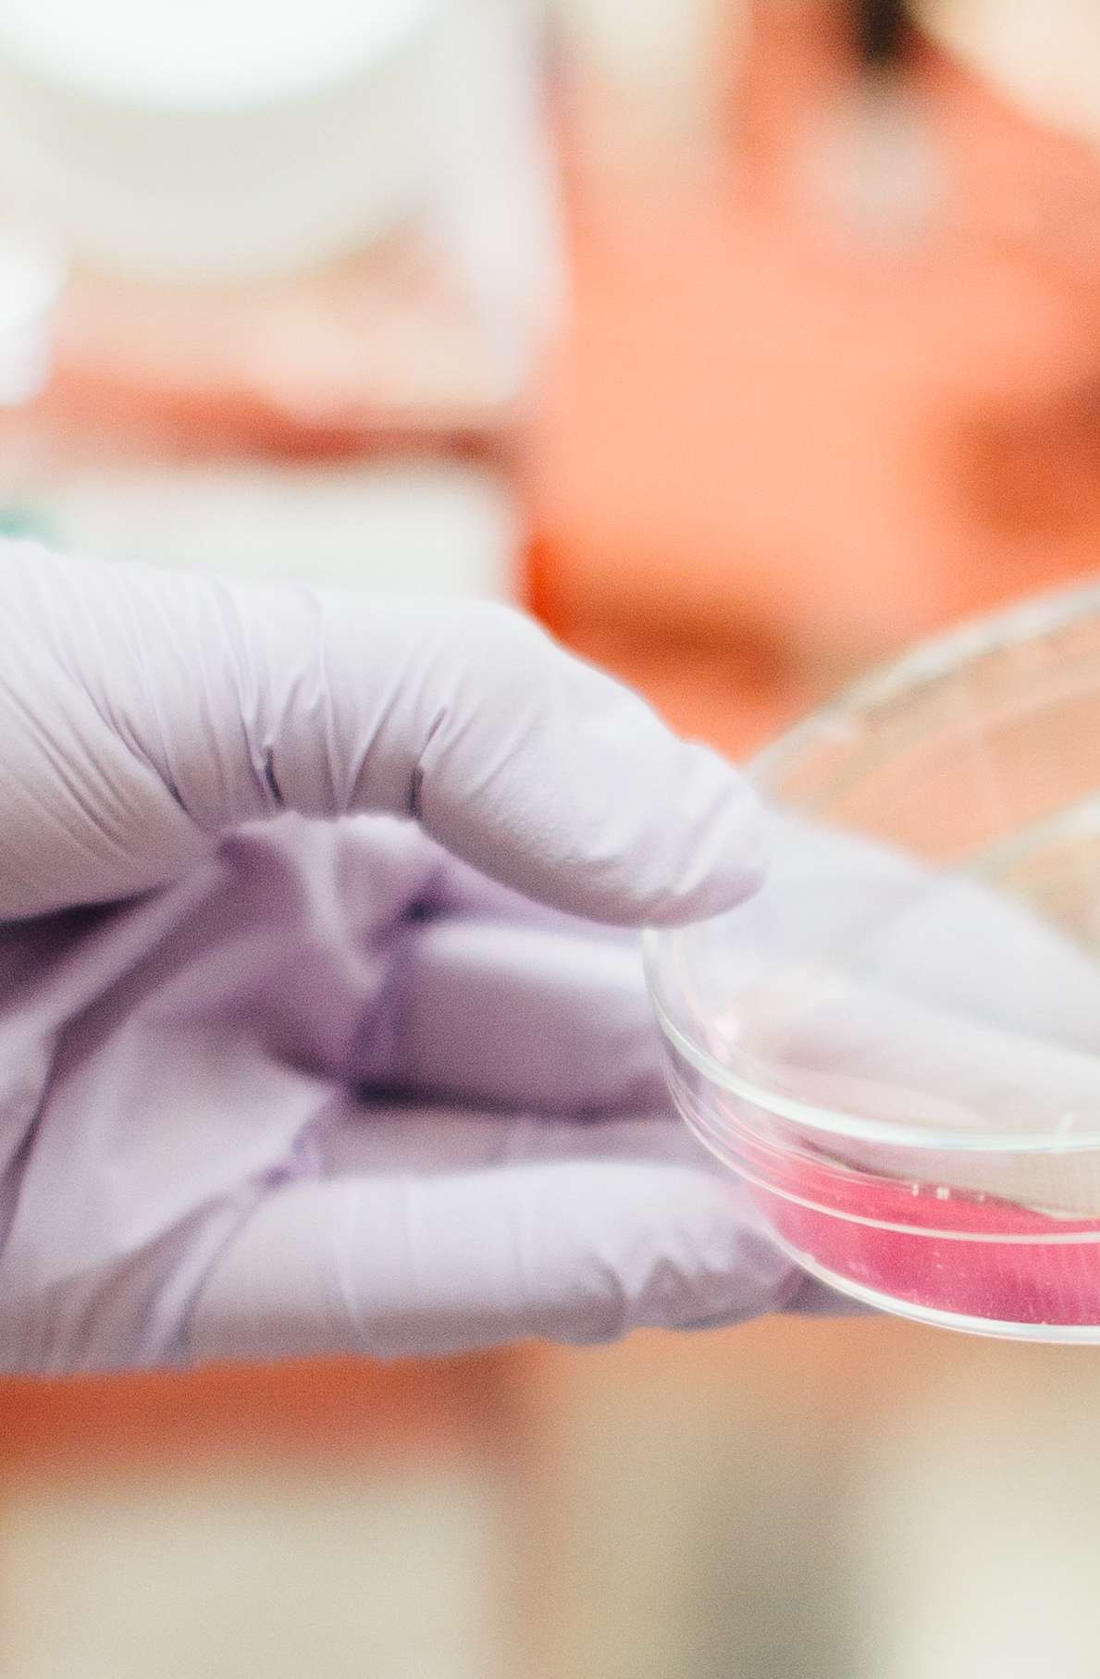
Ambition:
We will develop advanced health data science tools and technologies to analyse complex and diverse health data and seize its power to solve health challenges
Science – Activating world-class health data science
Priorities:
Human Phenome Project
Applied Analytics
Understanding the Causes of Disease
Better, Faster and More Efficient Clinical Trials
Improving Public Health
Better Care
Notes:
We are leading a new era of scientific convergence, where computational, population, social and biomedical research communities come together to tackle complex health questions using large scale health data. HDR UK is combining health expertise with new tools and technologies to enable a data-led approach to reduce the time from scientific discovery, to intervention, and through to innovative patient treatments. We aim to revolutionise the ability to understand, prevent, diagnose and treat the most prevalent and devastating diseases, such as dementia, cardiovascular disease, cancer and rare genetic disorders.
Underpinned by our Data as Infrastructure Programme, we are seeking the leading maths, statistics, computer science and interdisciplinary teams and providing development opportunities, through our talent and training programmes to maximise their strengths. We will challenge them to develop analytical methods and support them to produce and scale tools to shape the future of healthcare.

Slide 7
An outstanding partnership
Our initial investment supports six research sites. Each has world-class expertise; a track record in using health data to derive new knowledge, scientific discovery and insight; and works in close partnership with NHS bodies, industry and the public to translate research findings into benefits for patients and populations.
Wales and Northern Ireland (Swansea and Queen’s University Belfast)
Midlands (Birmingham, Leicester, Nottingham, Warwick)
3
Scotland (Glasgow, Edinburgh, Dundee, Aberdeen, Strathclyde, St Andrews)
1
London (Imperial, Kings, London School of Hygiene and Tropical Medicine, Queen Mary, UCL)
1
2
Oxford
6
5
4
Cambridge (EBI, Sanger, Cambridge University)

Slide 8
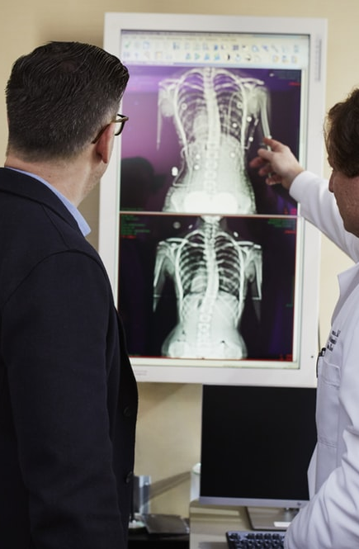
Ambition:
We will create a world-leading data infrastructure and UK-wide approach to secure data services to accelerate scientific research and digital innovation
Priorities:
Establish an ecosystem of Health Data Research Hubs
Develop an Innovation Gateway to provide safe and secure access to the UK’s health data
Establish the UK Health Data Research Alliance
Maximise the impact and learning from the Sprint Exemplar projects
Enable proportionate, rigorous, efficient and transparent information governance across the UK Health Data Research Alliance
Facilitate fair capture of value by the NHS and government for the benefit of patients and UK tax payer
Infrastructure – Uniting the UK’s health data
The Digital Innovation Hub Programme is funded by the Industrial Strategy Challenge Fund
Notes:
We will improve health data access by creating rich, robust and reliable infrastructure and embedding a strong governance framework with leadership and engagement of the public. Researchers from across disciplines, institutes and geographies will be able to access data and valuable insights through:
Digital Innovation Hubs: specialised research services and trusted research environments based on areas of expertise, such as disease area, therapeutic area, research activity, and region. But this is not a research project – Hubs will be expected to provide data, curate the data and offer services for research and innovation.
UK Health Data Research Alliance: facilitating partnerships across NHS organisations and a consistent approach to tools, technologies, governance, data provision and public engagement
Infrastructure layer: providing access, including access to the HDR UK Phenomics online library resource, and de-identification, policy, standards, tools and best practices for using data

Slide 9

Ambition:
We will create 10,000+ health data scientists spanning all career stages, from school-leaver to senior research manager and international opinion leaders
People – Empowering health data scientists
Priorities:
School leavers
Postgraduate
Post doctoral
Supporting career pathways
Notes:
The UK has a rich and diverse scientific talent base, thanks to the strength of the NHS, our academic institutions and innovative scientific and digital industries. We aim to harness this, and bring on board our international peers, to create a community of health data scientists with new skills that will dramatically change medical research and open up new, faster, smarter pathways to patient care.

Slide 10
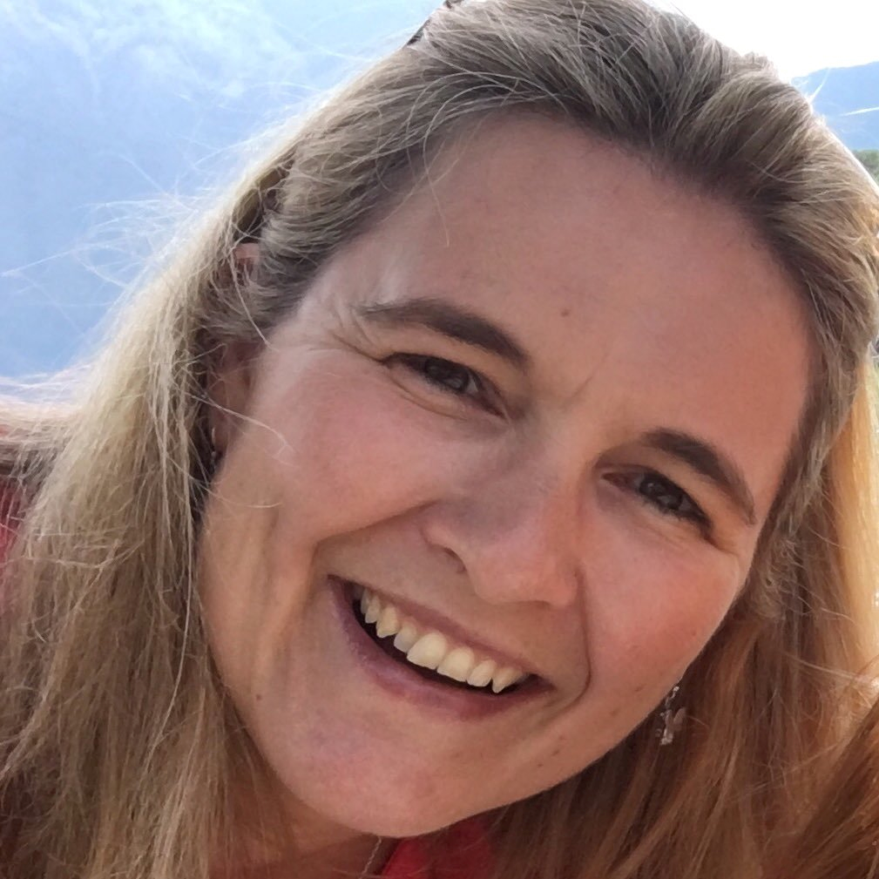
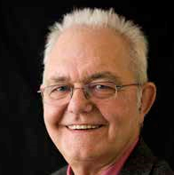
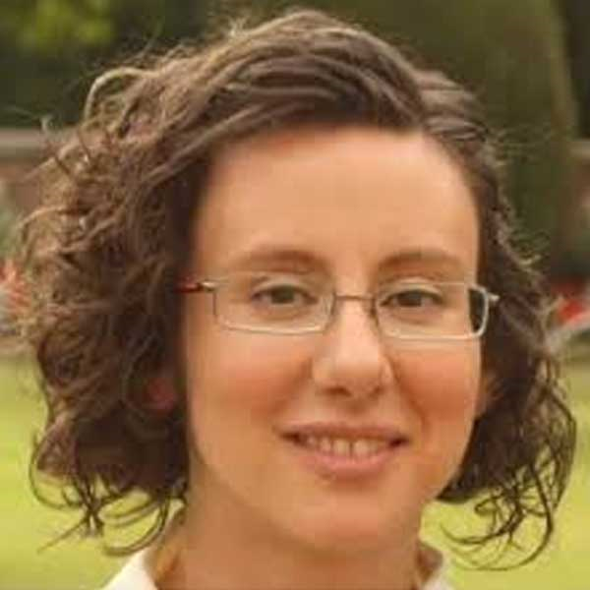

Training Strategy
~University pay scale
6/7
7/8
8/9
9/10
Education
Training
Consolidation
Exploration
Progression
Independence
Leadership
Masters Programmes
PhD Programme in Health Data Science with the Alan Turing Institute
Post-doctoral Fellowships
Training at Scale
Biological, clinical or mathematical / physical sciences
Career wide training: Secondments / Sabbatical, Modular training / e-learning
Diploma
MSc
Training fellowship/ post doc
Tenure track/lecturer/fellowship
PI
Apprentice / A levels
PhD
BSc
Training post
Technology specialist/data scientist
Senior tech specialist/data scientist
Principal tech specialist/data scientist
Career pathways for interdisciplinary health data scientists
Train up to 10,000 data scientists
Career wide: industry roles and joint appointments
Notes:
Consultation highlighted current barriers:
Disciplines are often siloed & lack of opportunities for application of knowledge and consolidation of skills
Inappropriate markers of esteem and lack of clear career paths
HR structures insufficiently flexible and uncompetitive pay scales
There is now an opportunity to:
Recognise critical roles of informaticians – not a service role
Support for individuals to apply their knowledge and for appropriate career development opportunities
Opportunities for intellectual leadership and independence
Clear career structures with defined criteria for progression
Access to flexible career wide training

Slide 11
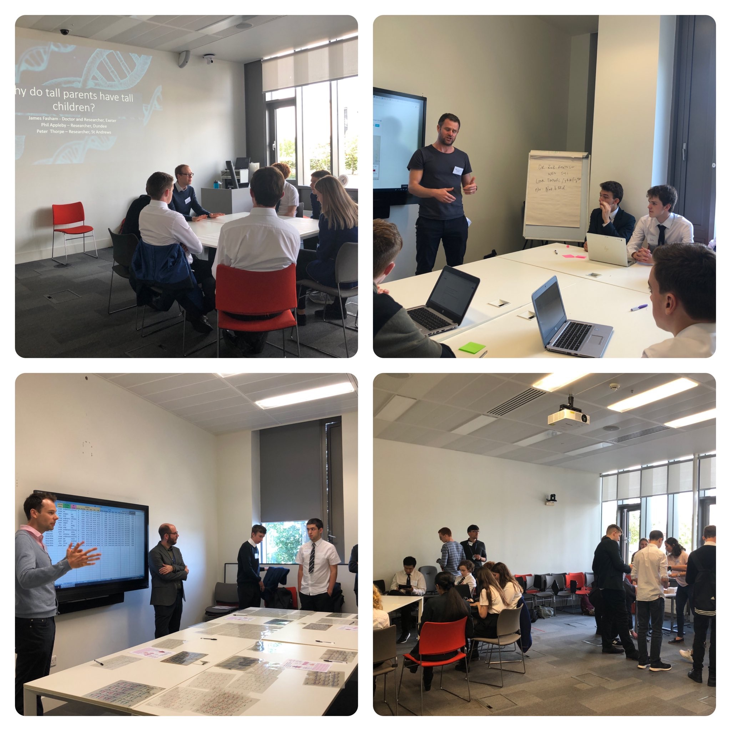
Training
Innovative career pathways in Health Data Science
Schools
BSc
MSc
PhD
Training fellowship/ post doc
Continued Professional Development
Inaugural Schools Engagement Event
New activities developed by Fellows delivered to school pupils and made available online for others.
Florence Nightingale Lecturer
To be appointed in 2020
Lead a national team to develop and deliver schools engagement materials UK-wide

Slide 12
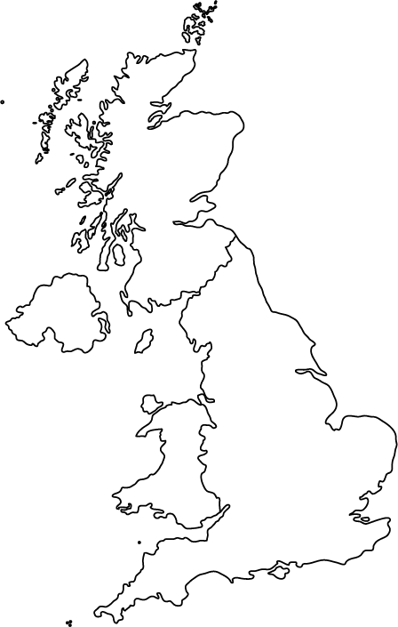
Training
Innovative career pathways in Health Data Science
Schools
BSc
MSc
PhD
Training fellowship/ post doc
Continued Professional Development
Masters Programmes and Scholarships
Six new programmes awarded funding
First programmes launching in September 2020
Developing linked level 7 Degree Apprenticeship opportunities
Partnership with DataLab
Co-funded Health Data Science scholarships at Scottish universities
Call expected November 2019
Health Data Science Educators Forum
Developing a forum to develop health data science educators and programmes across the UK

Slide 13
Training
Innovative career pathways in Health Data Science
Schools
BSc
MSc
PhD
Training fellowship/ post doc
Continued Professional Development
HDRUK/Turing Wellcome PhD programme
£6 million award for 25 WT studentships over 5 intakes
Additional support: 3 FTE HDR UK per intake; 3 FTE industry promised for October 2020 intake
4 year programme: year 1 training-intensive; years 2-4 thesis with opportunity to re-locate across HDRUK/Turing network
Targeting mathematical/computational sciences graduates keen to develop and apply innovative methodology to substantive health research problems
PhD Student Network Initiative
Local hub events: two organised in AI and Precision Medicine
National conference in 2020

Slide 14
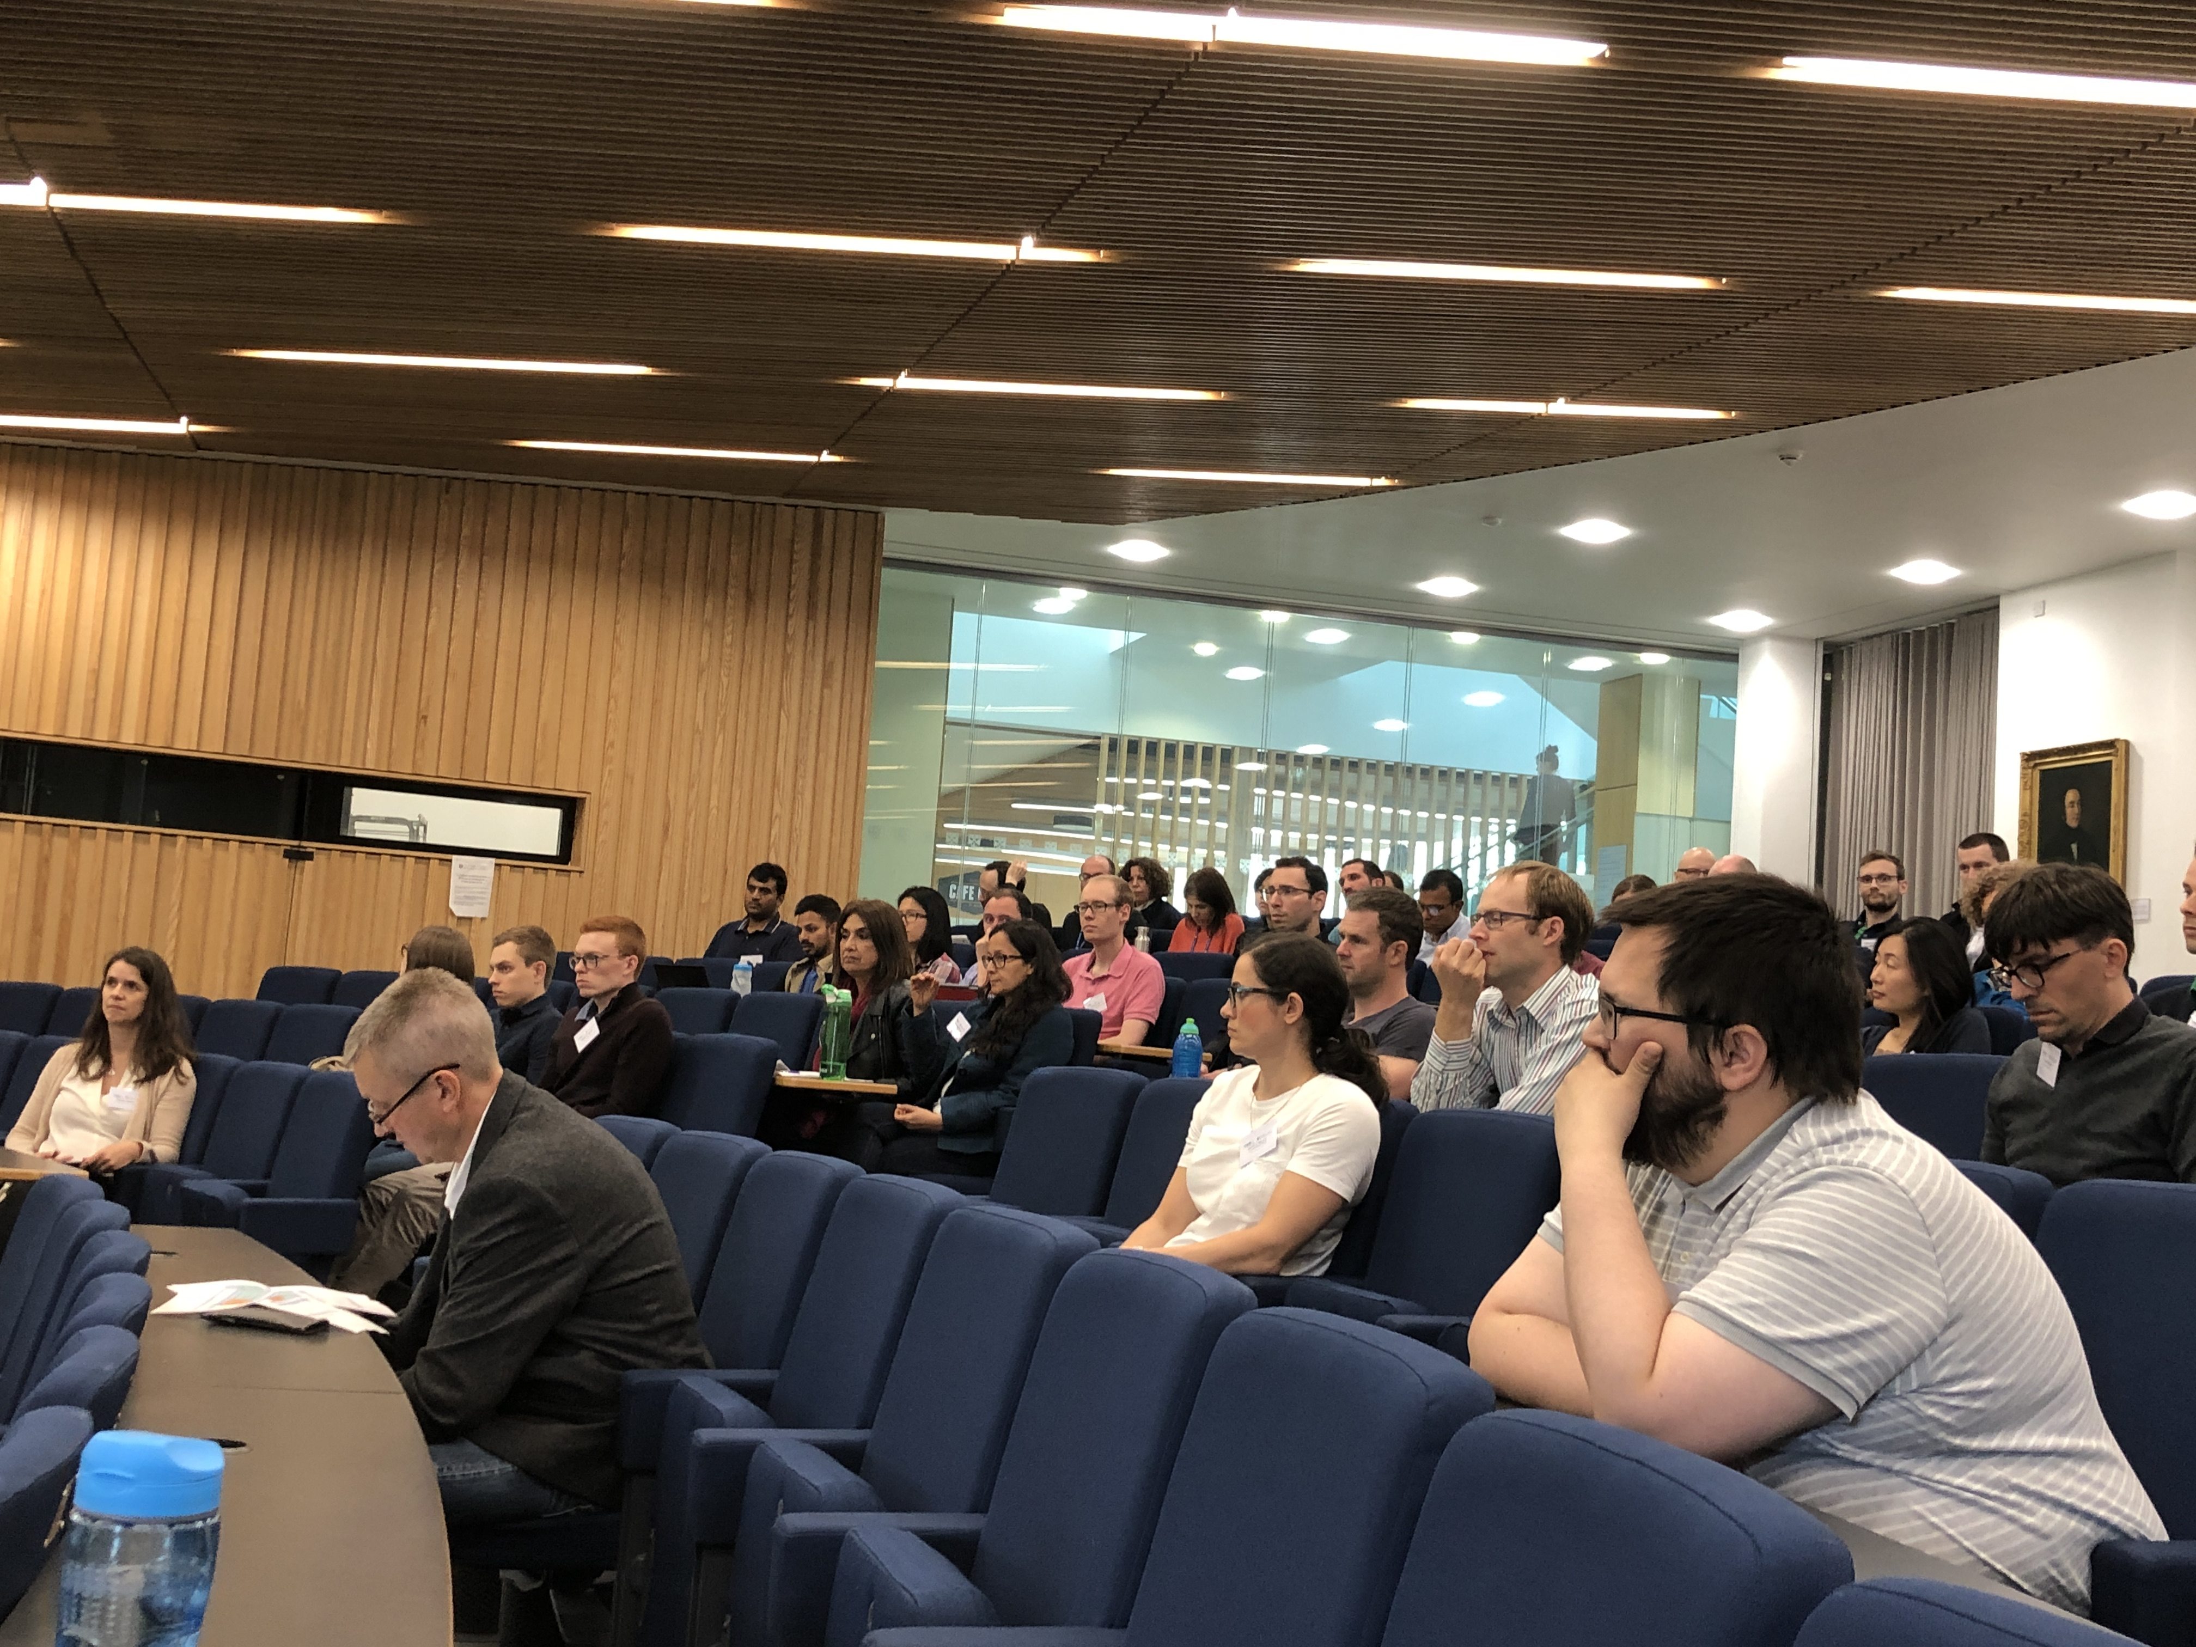
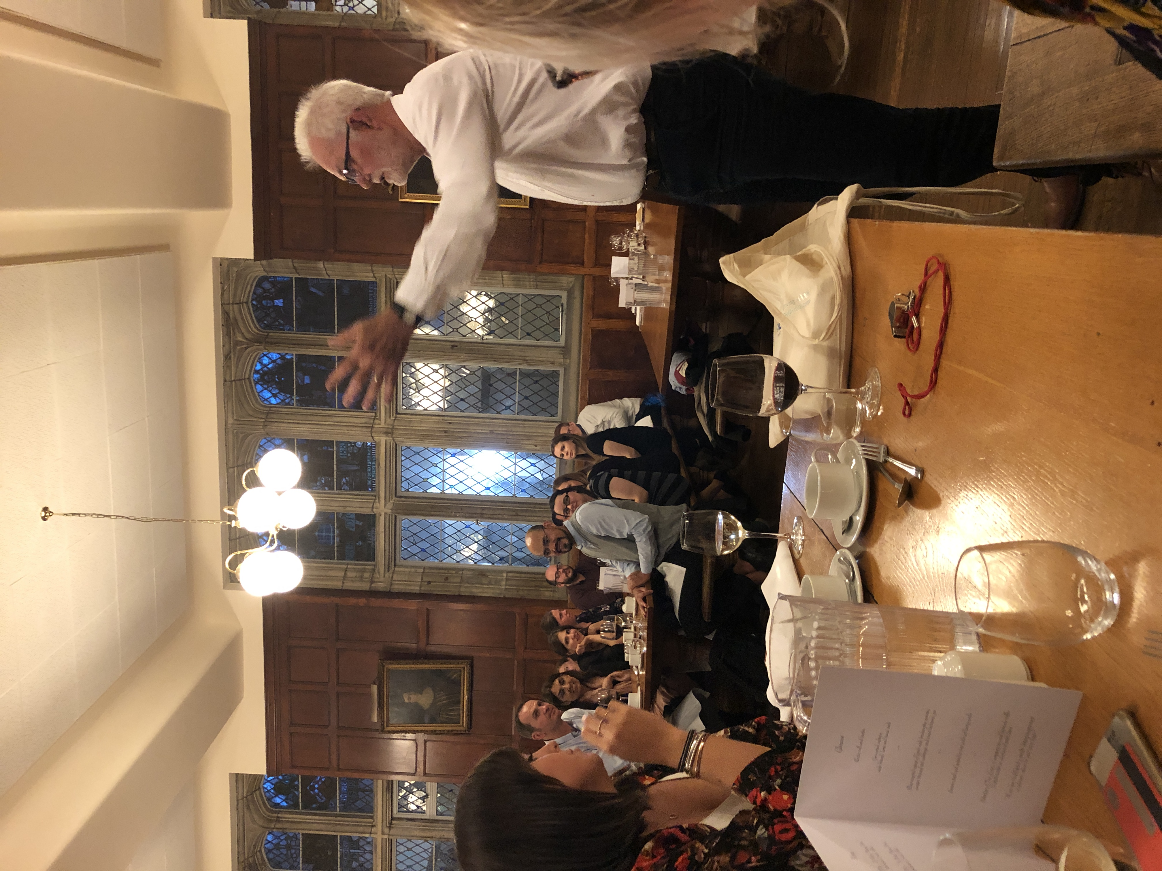
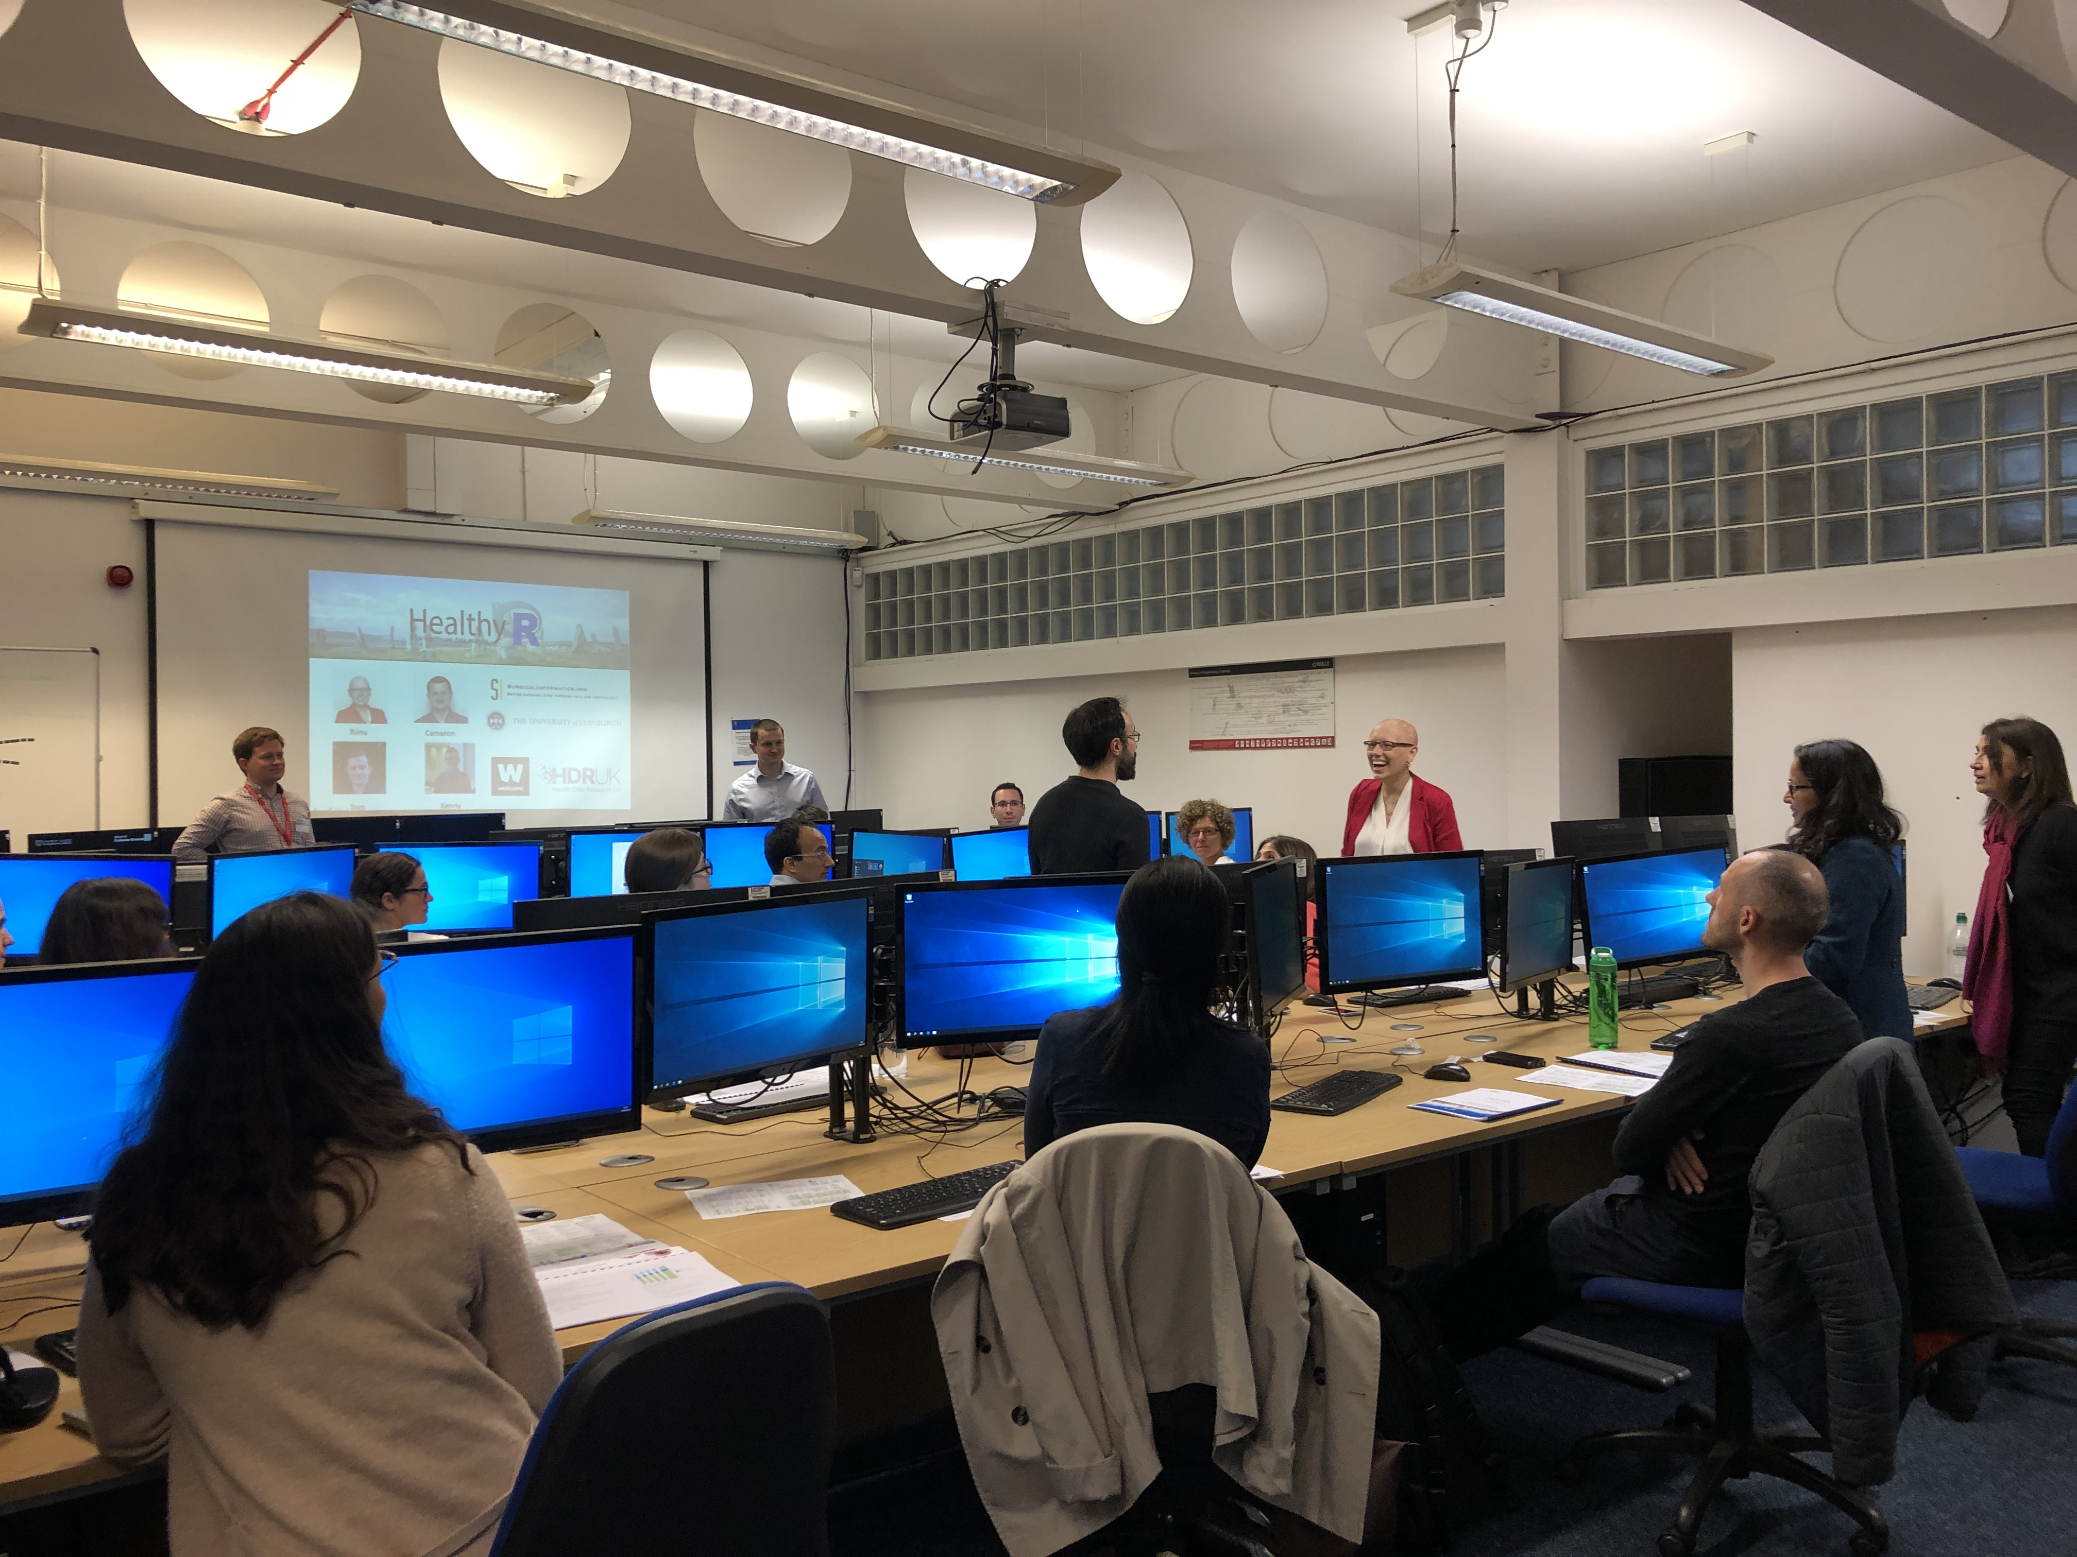
Training
Innovative career pathways in Health Data Science
Schools
BSc
MSc
PhD
Training fellowship/ post doc
Continued Professional Development
Fellows Training Programme (NIHR Incubator)
46 UKRI/Rutherford fellows
40 NIHR Incubator Fellows (clinically focused)
Five-day Summer School
Core and Advanced Health Data Science Workshops
Plenary Speakers & Fellow-led discussion workshops
Fellows Events
Upcoming event on transitioning to leadership roles & Development of collaborative research proposals
Joint event with HealTAC network on transferrable skills, with an NLP focus

Slide 15


Training
Innovative career pathways in Health Data Science
Schools
BSc
MSc
PhD
Training fellowship/ post doc
Continued Professional Development
Training at Scale
Build capacity in core analytical and computational skills for conducting reproducible research in health data science and informatics
A combination of online, open learning materials and trainer the trainer models
“Data Science for Doctors”
Better Care: Implementing a Learning Health Systems
Training Catalogue
230 training courses
Innovative Careers & Frameworks
Partnership with HEE: position paper & host round table discussions to define health data science roles and careers
Competency frameworks for clinical informaticians
Data Science Specialists Careers
Data Science Specialist Careers Workshop
Indicators framework
HDRUK policy

Slide 16
HDR UK / NHSR
AIMS
Strategic partnership for developing capability
Collaboratively build a portfolio of open source training materials on basic and specialized topics for short, hands on courses
Grow a community of trainers capable of delivering such materials & support the roll out of courses in academic institutions and NHS trusts
Support an infrastructure for training provision, on demand, accessible to all
ACTIVITIES
Joint training courses & Train-the-trainer activities
“Development hack” days for NHS-R and HDR UK communities – London (Jan 20th), Leeds (TBC) – events for sharing, learning, and development.
Leverage on the HDR UK network to access venues for NHS R user groups and annual conference
Explore how HDR UK can sustain access to Rstudio.cloud / training environments in the cloud / stack overflow solution
Routes to course accreditation
HDR UK Training catalogue to advertise NHSR training events
Feed into career pathway discussion

Slide 17
HDR UK / NHSR partnership
TRAINING CURRICULUM DEVELOPMENT
Level 1 (basic) and level 2 (masterclasses, 1-3 days)
Topics of interest: standard curriculum for stats course, exploratory data analysis, data visualisation, regression modelling, time series focus, machine learning, evaluated designs, discontinuity analysis, model checking and challenges, natural language processing, automation, package development, dashboard development, reproducibility Rmarkdown
Review existing materials from both communities and create a collection/signpost.
Aim to design 2-3 new masterclasses in 2020.

Slide 18
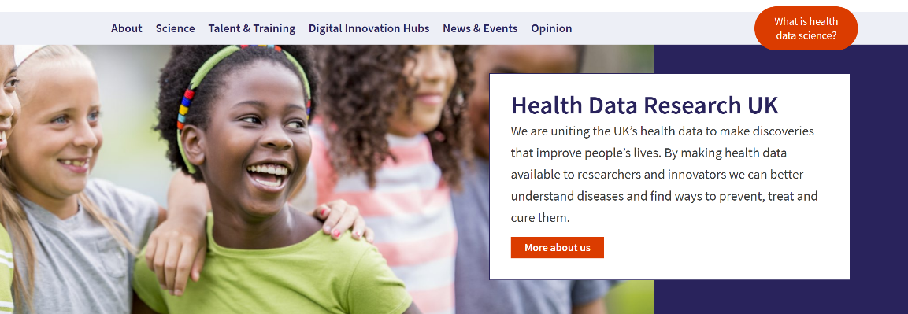
Find out more
For further information:
www.hdruk.ac.uk
enquiries@hdruk.ac.uk
@HDR_UK

Slide 19

Ambition:
We will encourage more effective health data science by involving users at all stages of the innovation process
Public Engagement and Involvement
Priorities:
Patients and the public will inform our direction, policy, decisions, planning and delivery
We will be transparent, open and accountable on how and why data are gathered, stored, secured, safeguarded, accessed, used and shared
We will be innovative in our approach and use mechanisms and stories that help earn public trust
Notes:
Interactions with the public will provide opportunities for mutual learning and instil the benefits of using health data for research. The public will be with us at every step to inform our planning and delivery and ensure we are acting in their best interests and with their backing.
Working in partnership with national organisations and charities, including the NHS, Understanding Patient Data, Genomics England, and the Association of Medical Research Charities, we will maximise opportunities for public engagement. Our narrative and delivery will be aligned to strengthen our combined reach and provide clarity on how and why UK organisations are using their health data. We will learn from and share best practice with UK and international organisations and seek opportunities for strategic partnerships with the commercial sector.

